Slide 1
Scoring Mechanism
Robust scoring method to assess quality of data

Slide 2
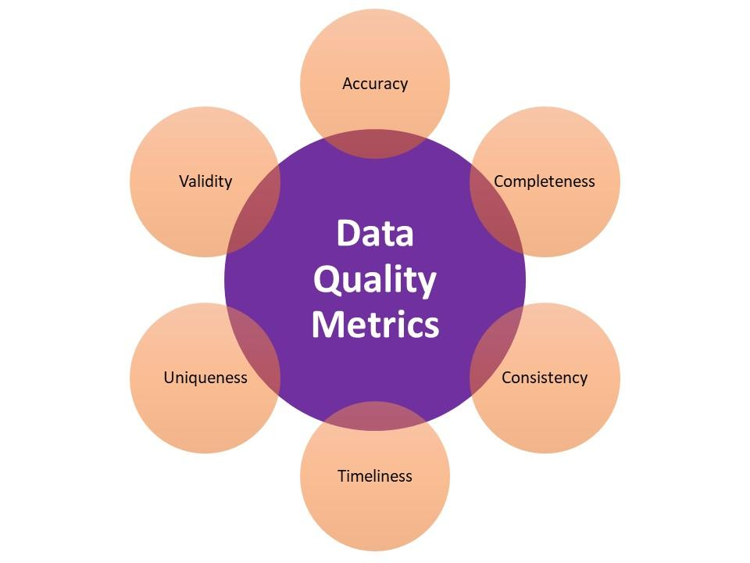
Data Quality Metrics
Notes:
Timeliness : Customer address if updated should be updated and updated data should be used . This should be ensured
Multicolumn eg : PM2.5 < PM10 always . Check it

Slide 3
Data Completeness

Slide 4
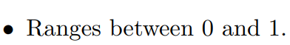
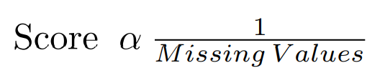
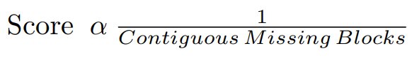
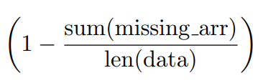
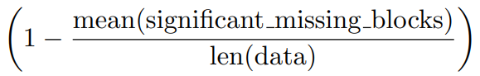
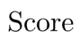
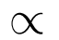
Data Completeness
Score
Missing Values
Missing Values
Contiguous missing blocks (CMB)
Contiguous missing blocks

Slide 5
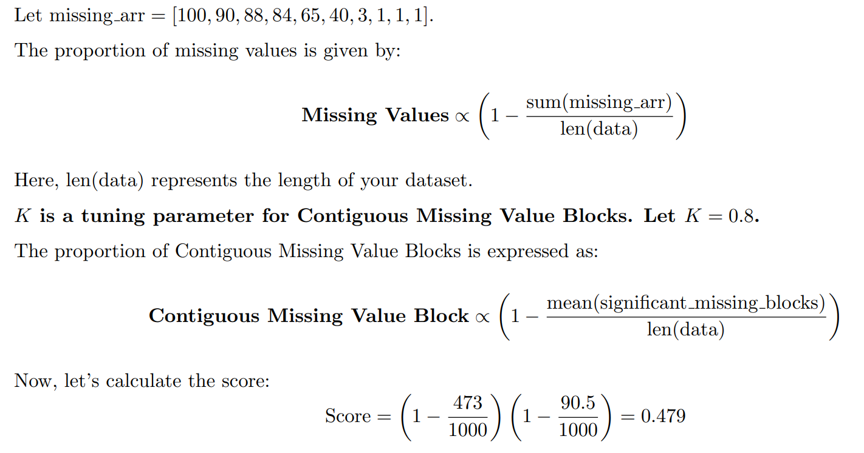
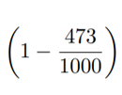
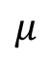
Score: Example
Blocks in Time series that are missing
Find mean
$$μ$$

Slide 6
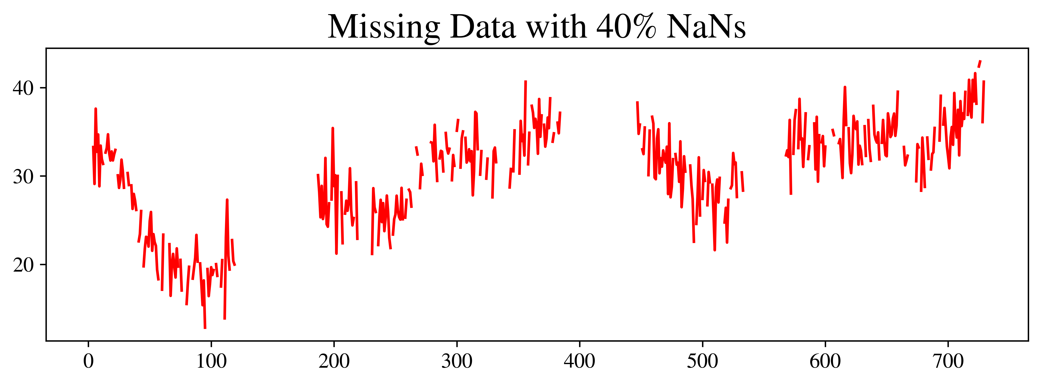
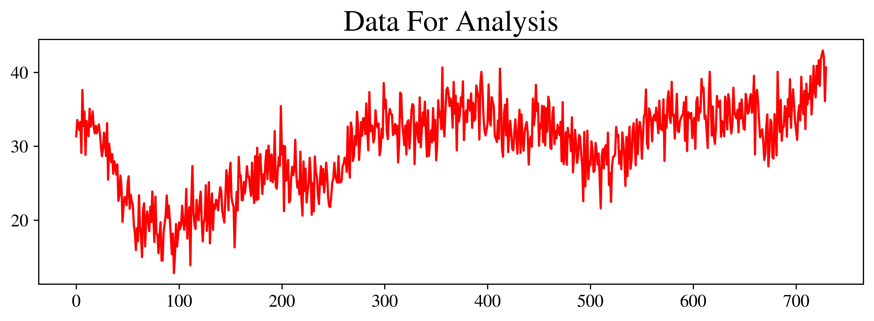
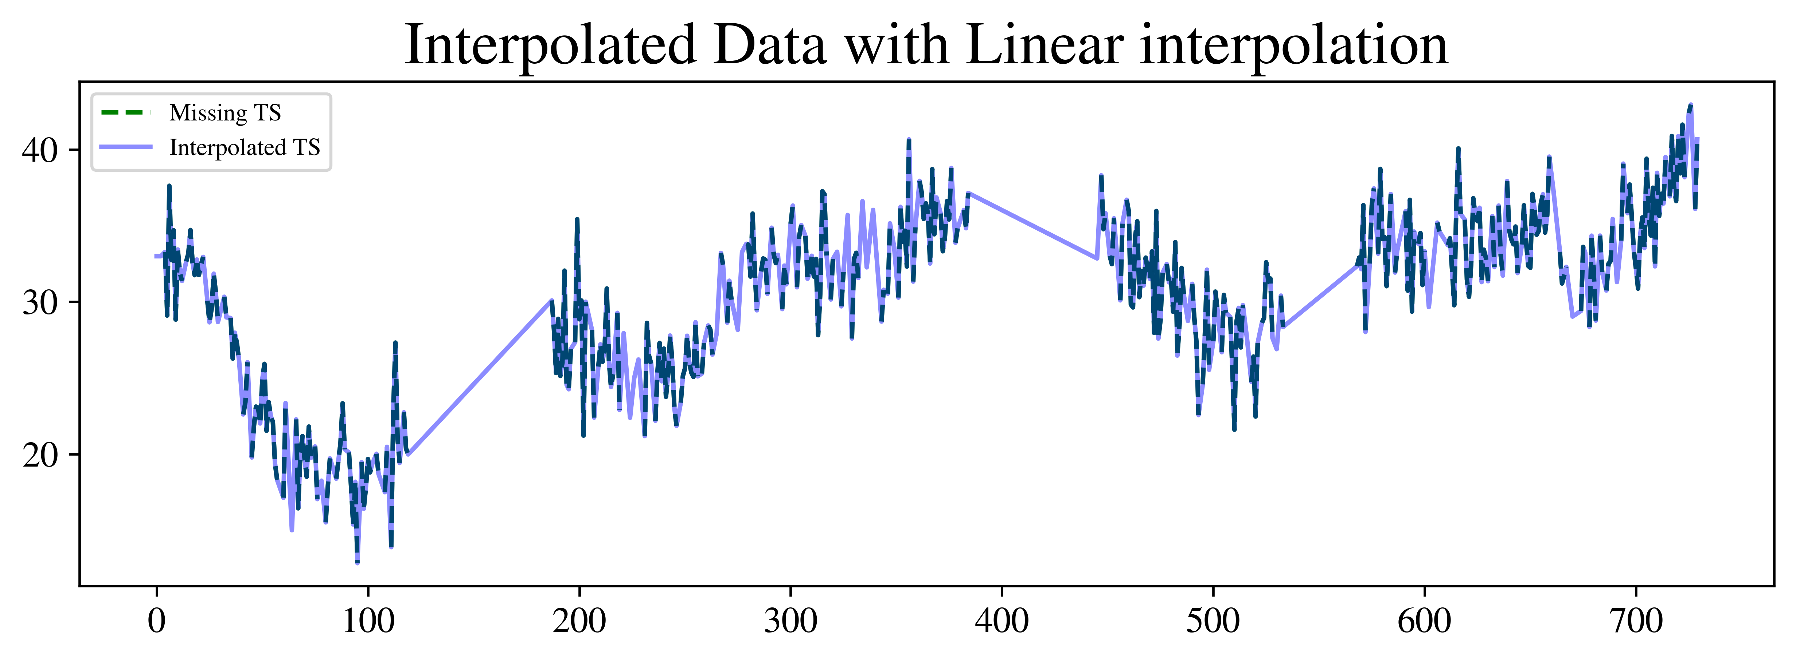
Data Completeness Check : Flow
Find Score
Spline
KNN
Linear
Find RMSE b/w curves
To Do: Depending on missing block length we might use different interpolation techniques
Update Scoring Mechanism if Required

Slide 7
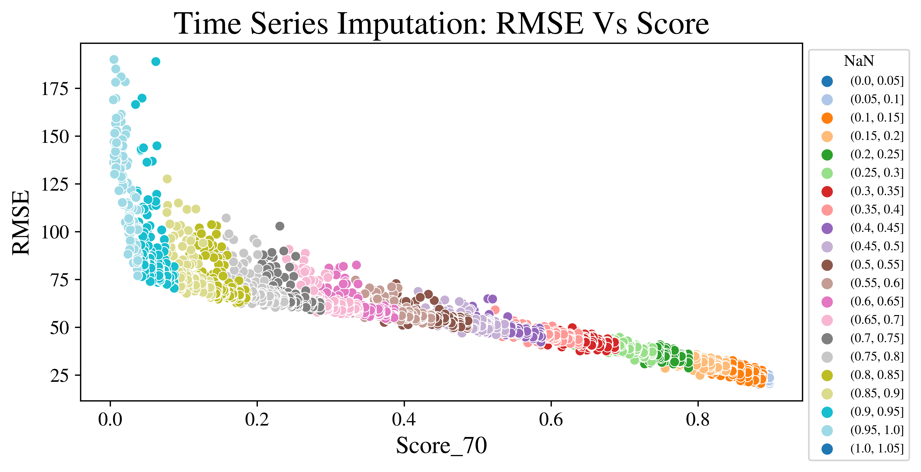
Plot For TS Imputation
KNN Interpolation

Slide 8
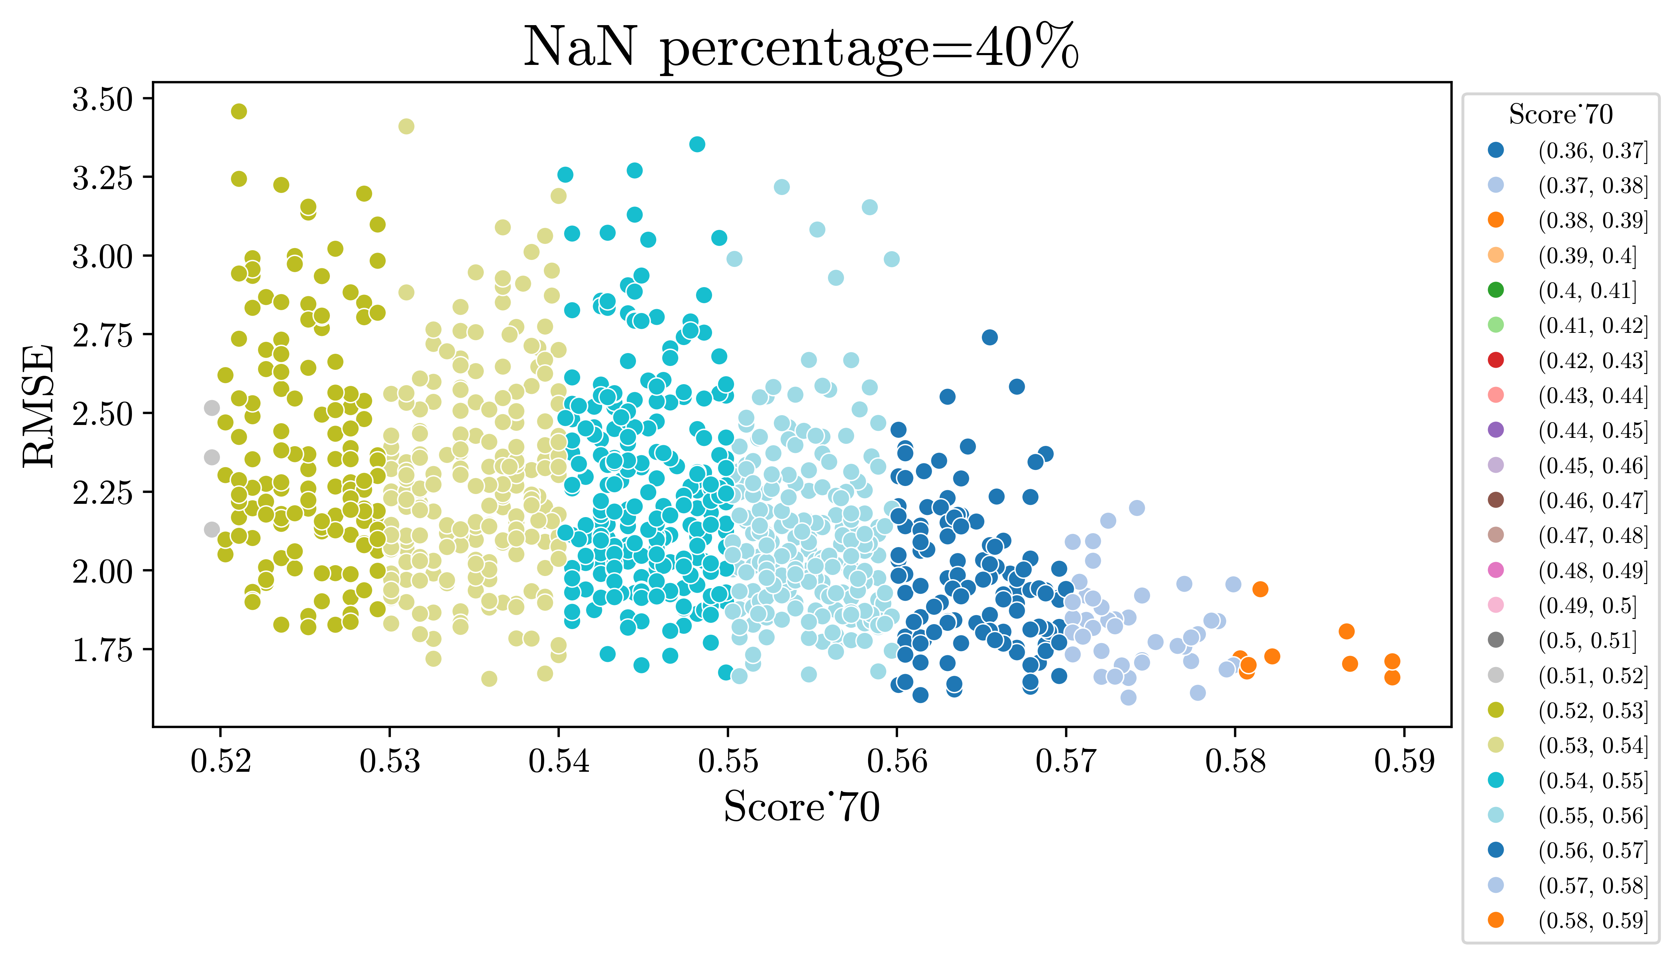
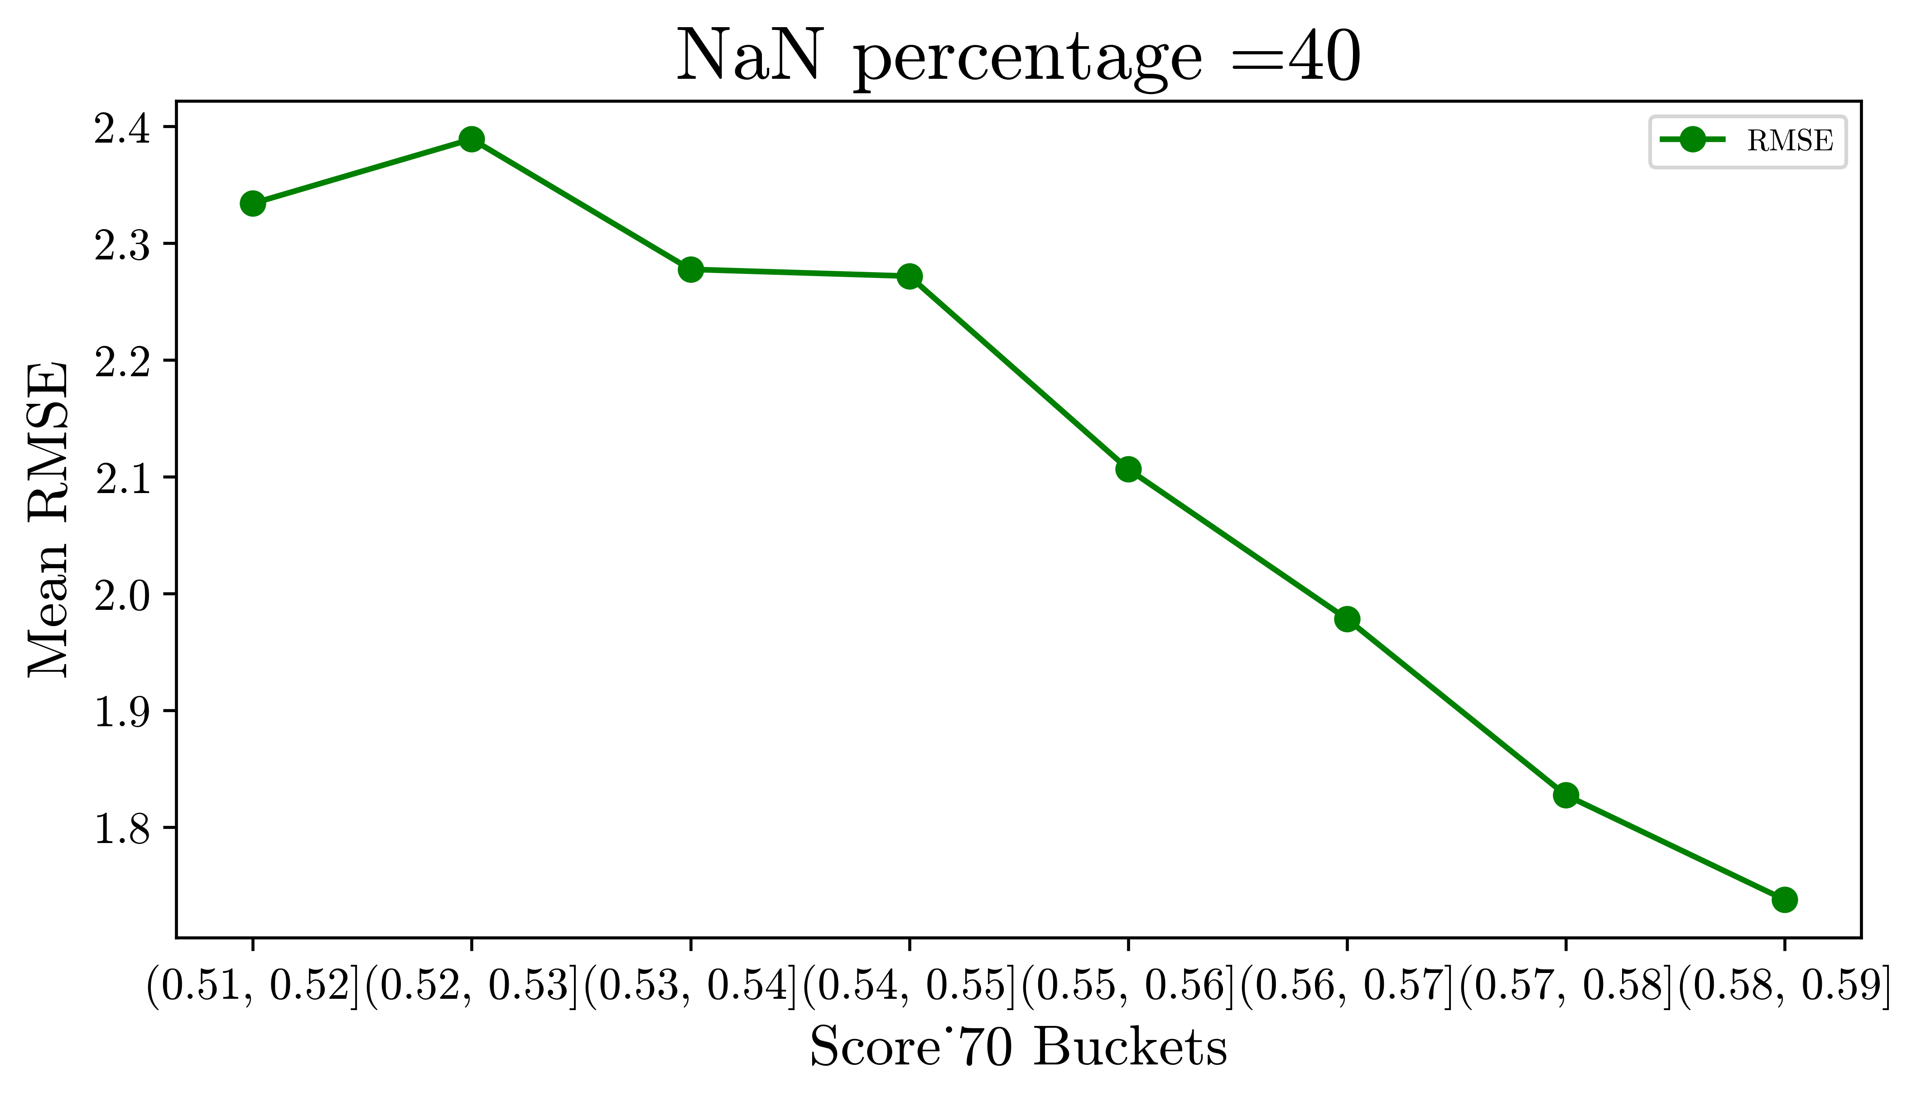
Incremental Benefit

Slide 9
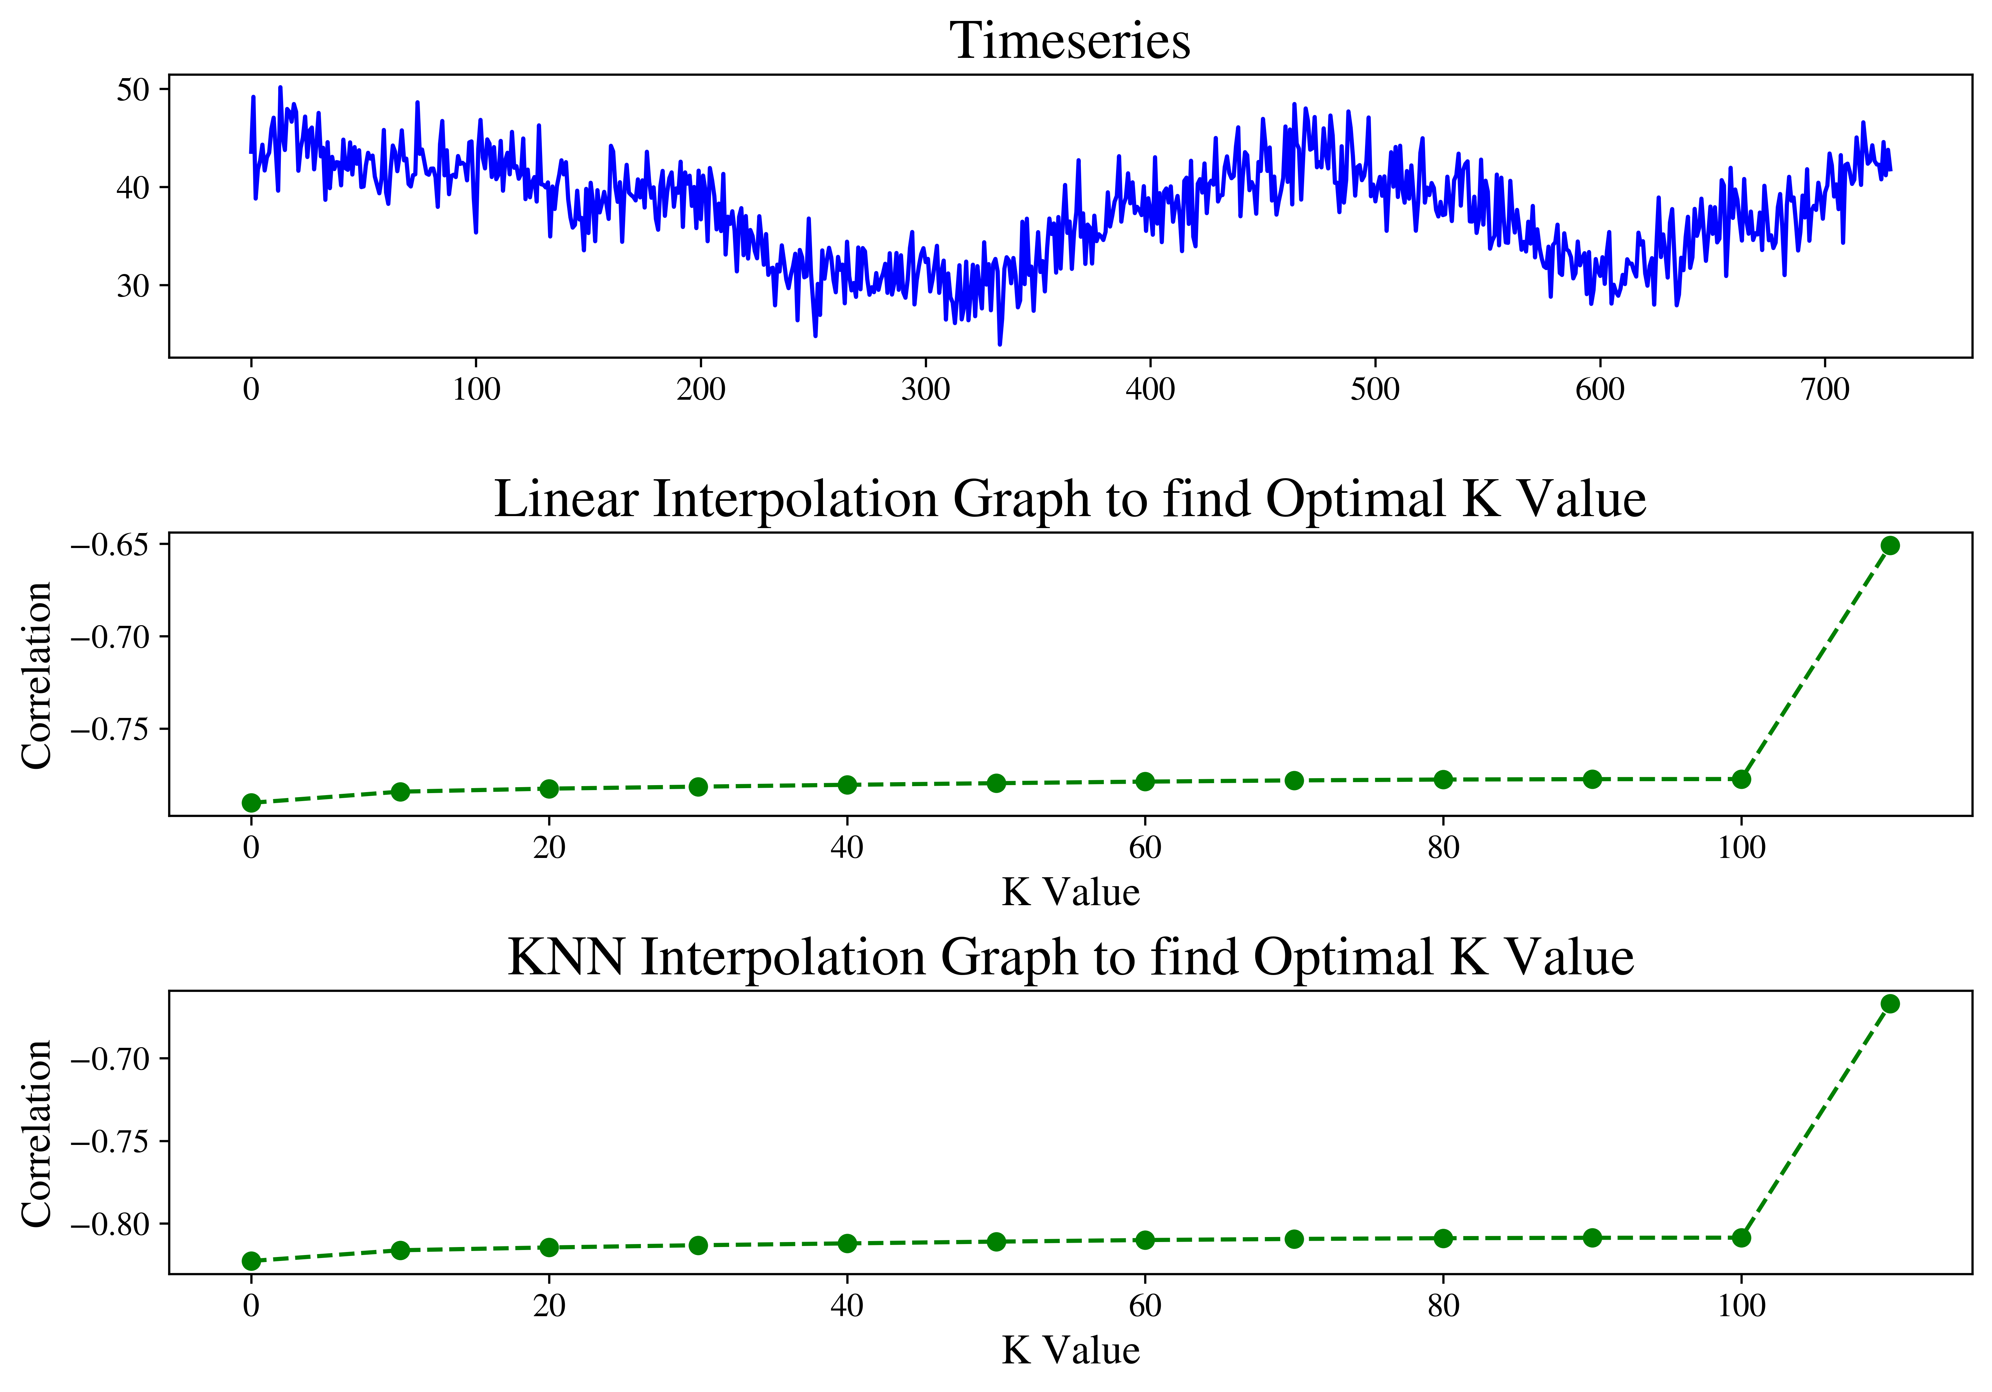
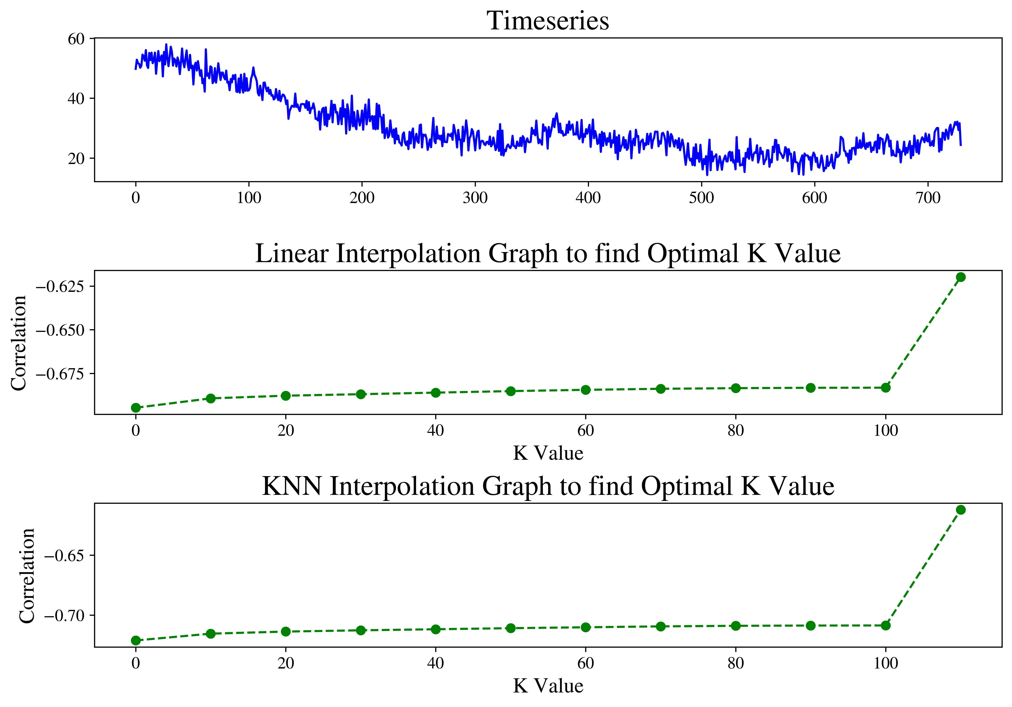
Tuning for optimal K Value
Correlation b/w Score and RMSE on Y axis | Scoring Threshold on X axis
Value at x=110 is Correlation for NaN’s Vs RMSE

Slide 10
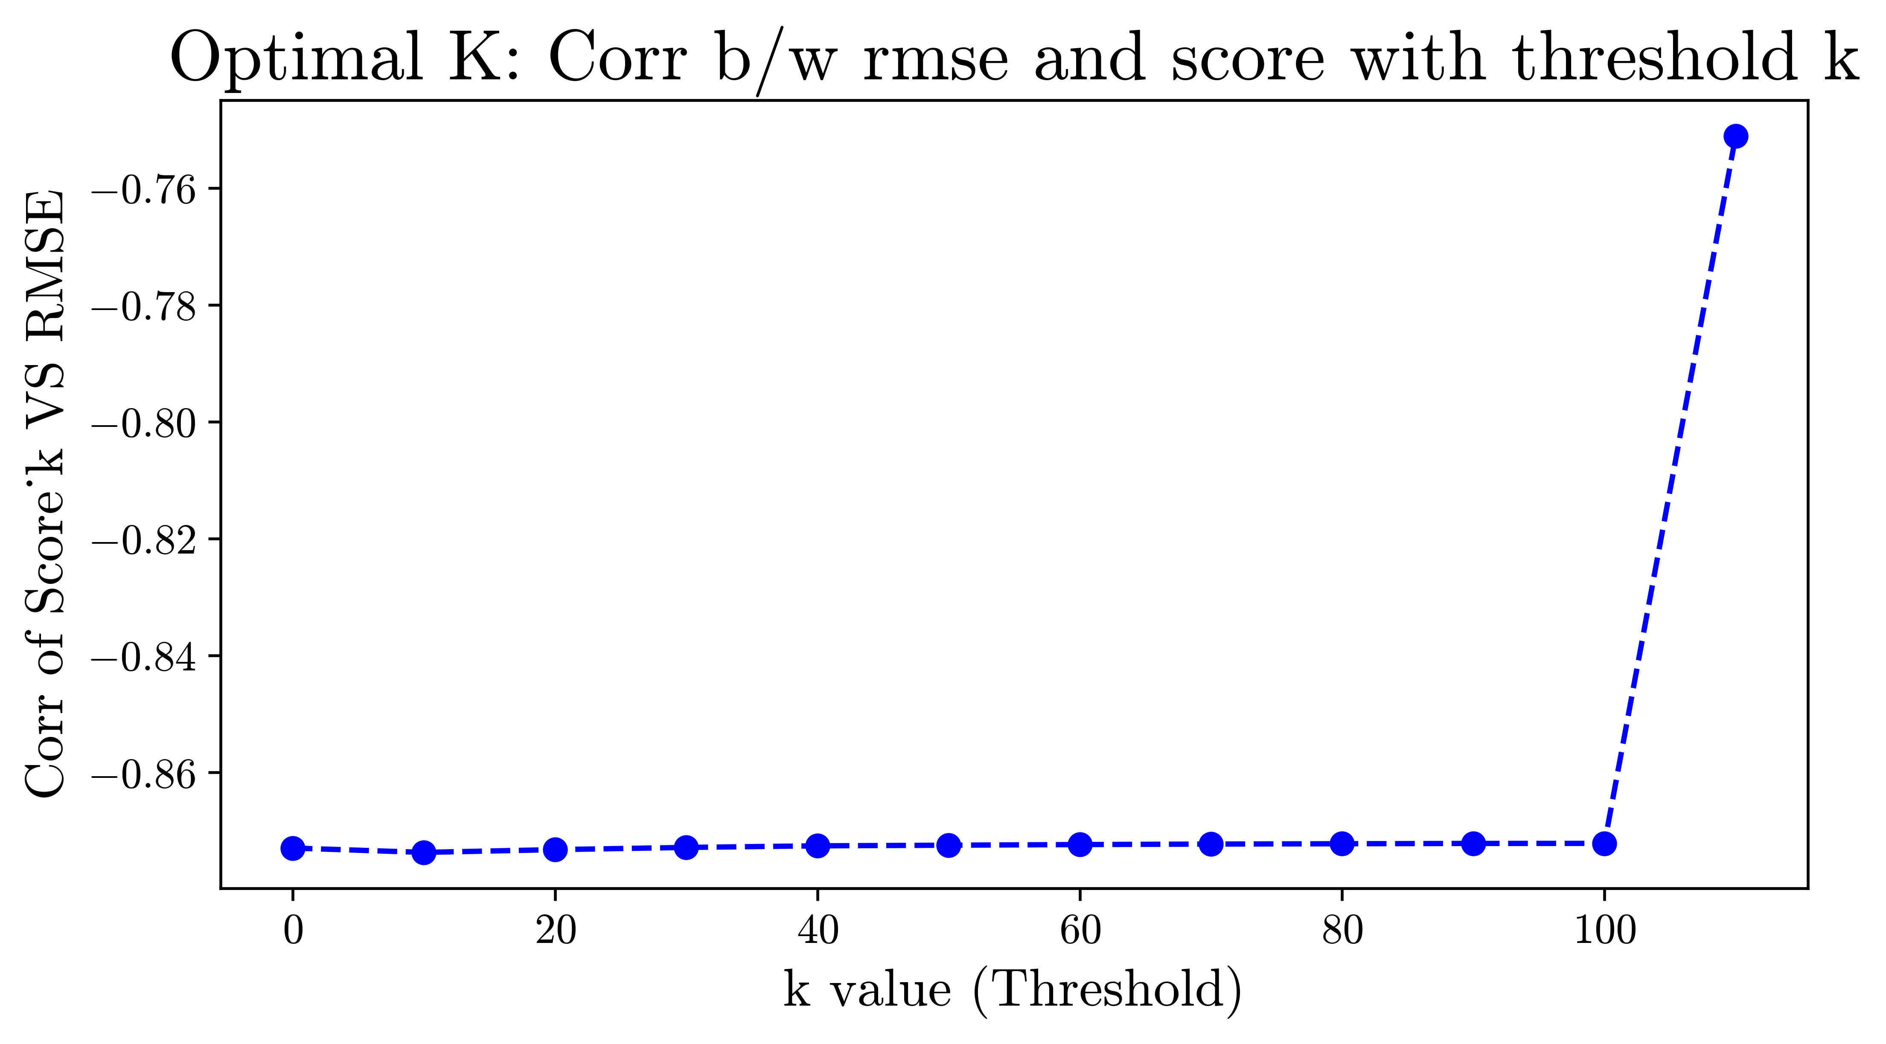
Optimal K Value
Correlation suggest score is almost independent of tuning parameter K
Our custom scoring function seems to be more correlated than NaN % Score

Slide 11
Feed Back Loop : Clustering
Find Score
KNN
Linear
50 x 731 : Shape
K=4
Evaluate Clustering
K – Means Clustering

Slide 12
Feed Back Loop : Clustering
Find Score
Time series Data
KNN
Linear
Evaluate Clustering
K – Means Clustering

Slide 13
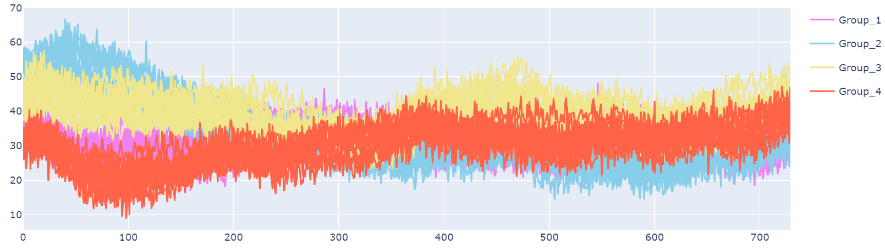
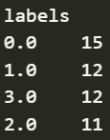
Data Generation

Slide 14
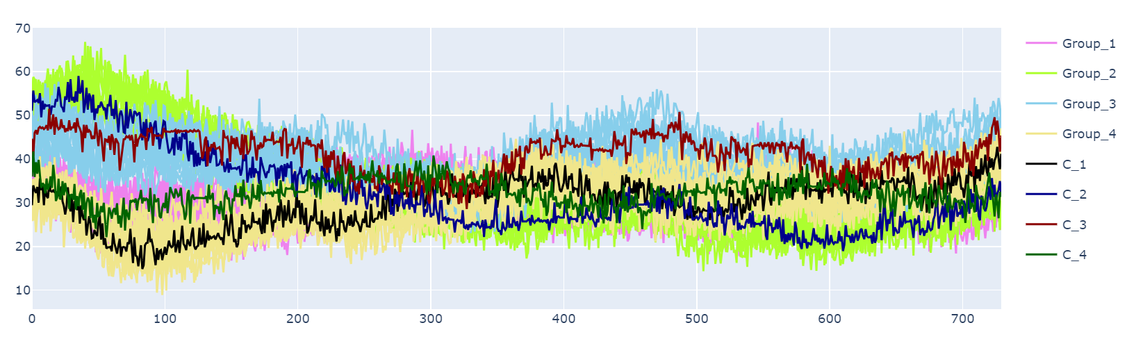
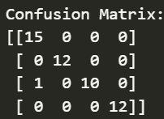
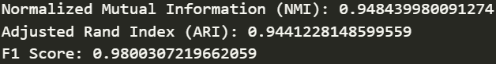
Clustering with no NaNs

Slide 15
Create Null Values
Choose NaN % to be removed
Random chunks of fixed % removed from all curves
Imputed missing data with Linear or KNN interpolation
Evaluated average custom score for all curves
Check correlation between Score and cluster evaluation metrics
Evaluate Clustering Metrics
Perform K Means clustering on imputed data

Slide 16

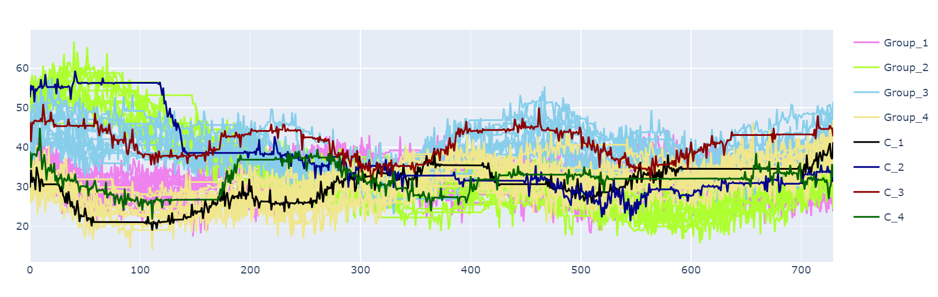
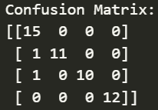
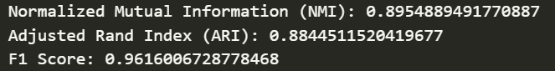
Clustering Imputed Data
KNN | Selective (65% NaN)
B/w interpolated curve and original data

Slide 17
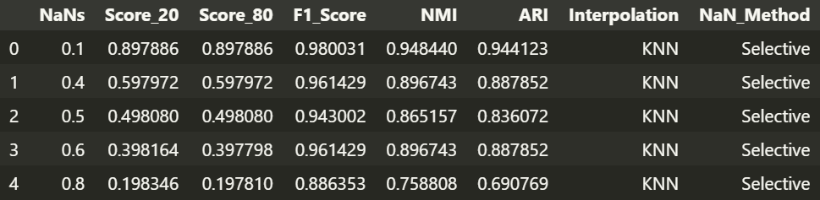
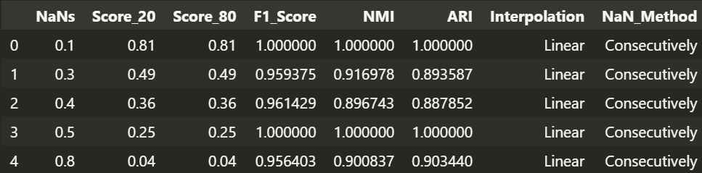
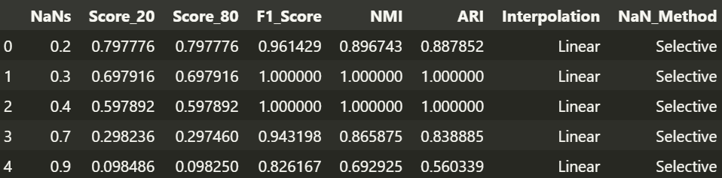
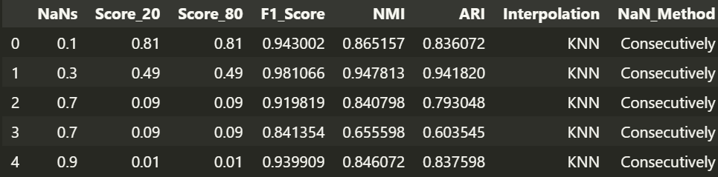
Clustering Results

Slide 18
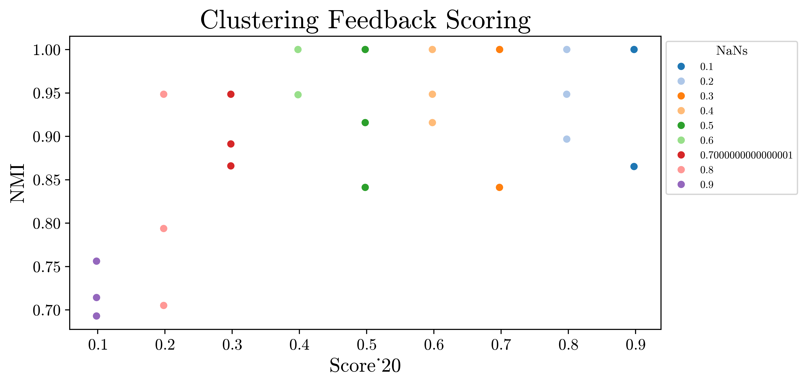
Clustering Feedback
Linear | Selective
We can see average NMI increases as score increases
NMI goes down if significant part of curve is missing and interpolated using KNN or linear.

Slide 19
Anomaly Detection

Slide 20
Anomaly Detection Flow Chart
MAD Detection
Timeseries Modelling
Tuning Parameters:
Window size
Threshold
Min Mad
Points may get misclassified in MAD.
Remove false positives using model
We try to create timeseries model and if data lies within a bound then it is not a outlier

Slide 21
MAD Detection
If a sudden spike dies less than 3 hours it is defined as an outlier
We need to find right set of parameters to detect such a situation
Small Window Size
Bigger Window Size
Median value of window will be high
Thus, points may not get classified as outlier
If too high almost becomes like global outlier detection.
Too high value becomes outlier

Slide 22
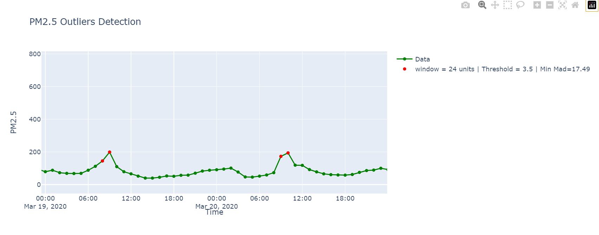
Choosing Right Parameters
Notes:
There seems to no siginifcant spike in value . And it peaks around 9 am for both days. So not outlier. Thus 24 time units not a good window size

Slide 23
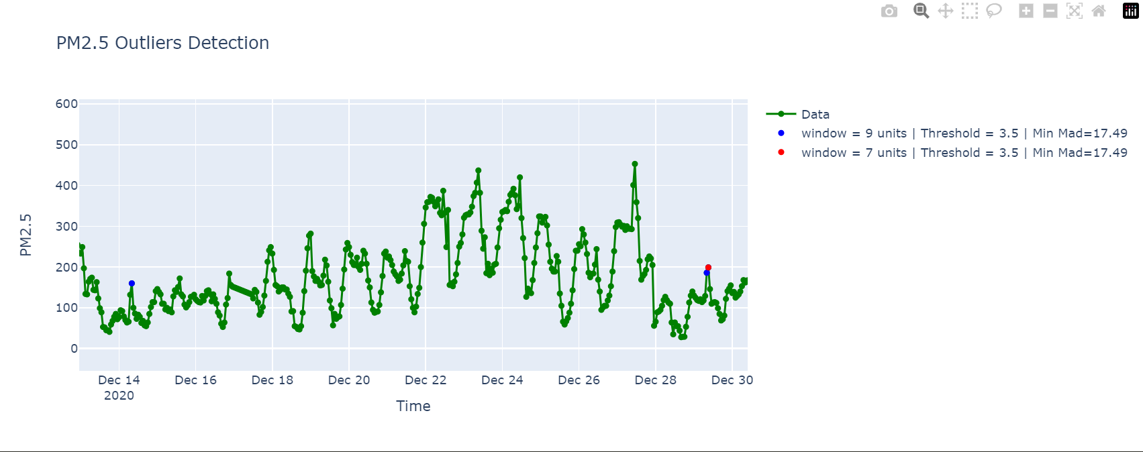
Choosing Right Parameters
Optimal Window Size = 9

Slide 24
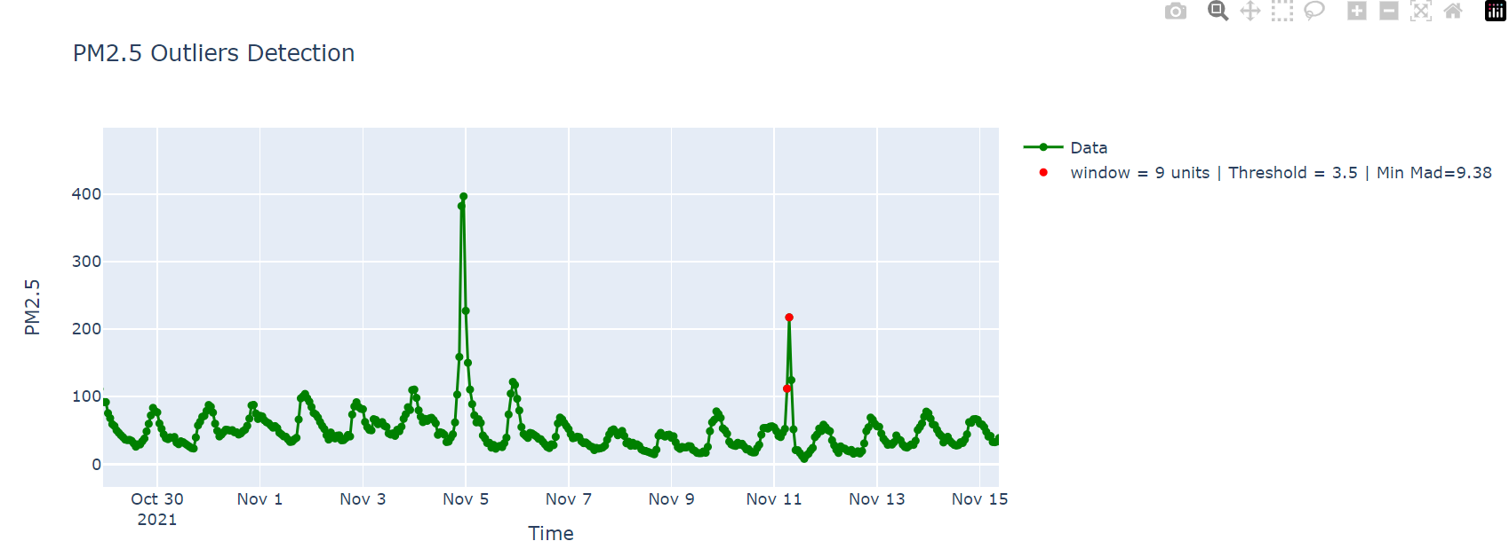
15 hours

Slide 25
15 hours
Sudden Spike Outlier detected
Sudden Spike Outlier detected

Slide 26
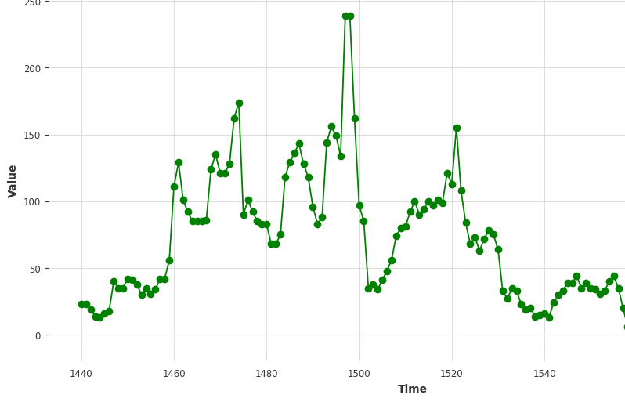
Time Series Model : Remove False Positives
Value to be Predicted
2
1
3
4
Model predicts t+5th hour data
Train : 24 hrs

Slide 27
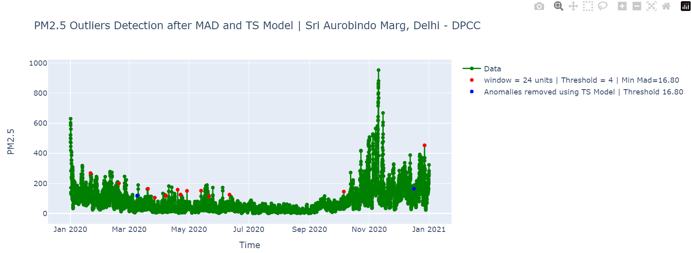
Removing False Positives

Slide 28
Distribution Checks

Slide 29
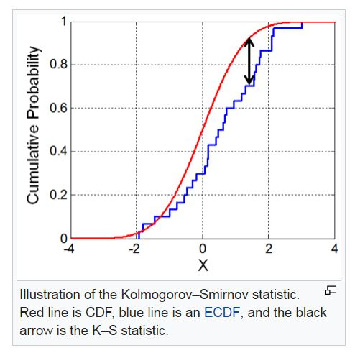
Distribution Checks
Choose 2 years data
Apply 2 sided K-S test
Finds CDF for both data
Find probability associated to KS statistic using table
Calculates KS Statistic i.e. max(absolute diff in CDF)

Slide 30
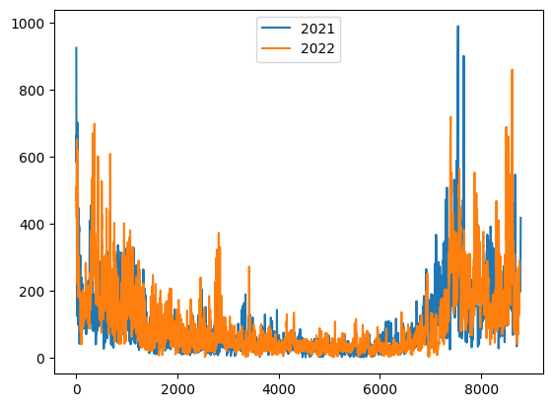
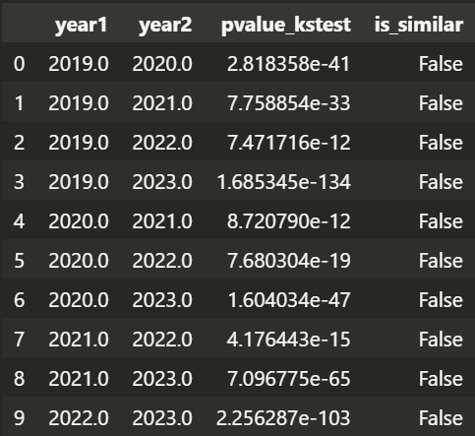
Okhla Phase-2, Delhi - DPCC
Fig: Hourly Data Resolution
Fig : PM2.5 Data

Slide 31
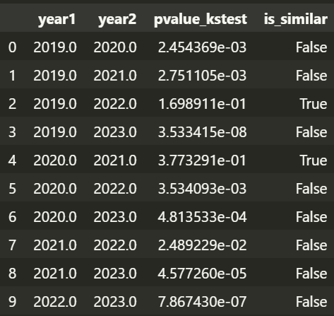
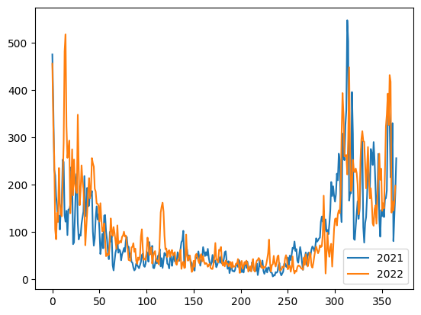
Okhla Phase-2, Delhi - DPCC
Fig : PM2.5 Data
Fig: One Day Resolution

Slide 32
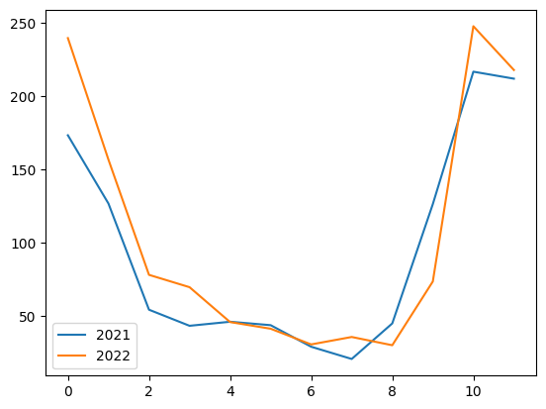
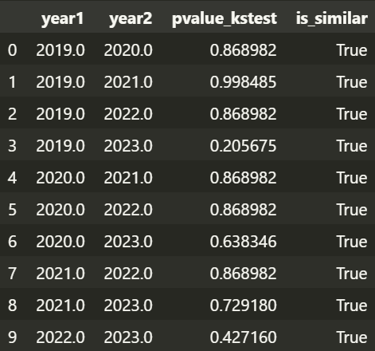
Okhla Phase-2, Delhi - DPCC
Fig: Monthly Data Resolution
Fig : PM2.5 Data

Slide 33
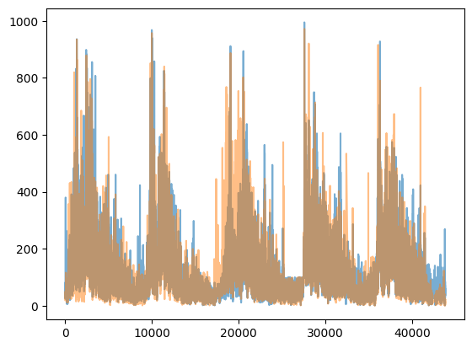
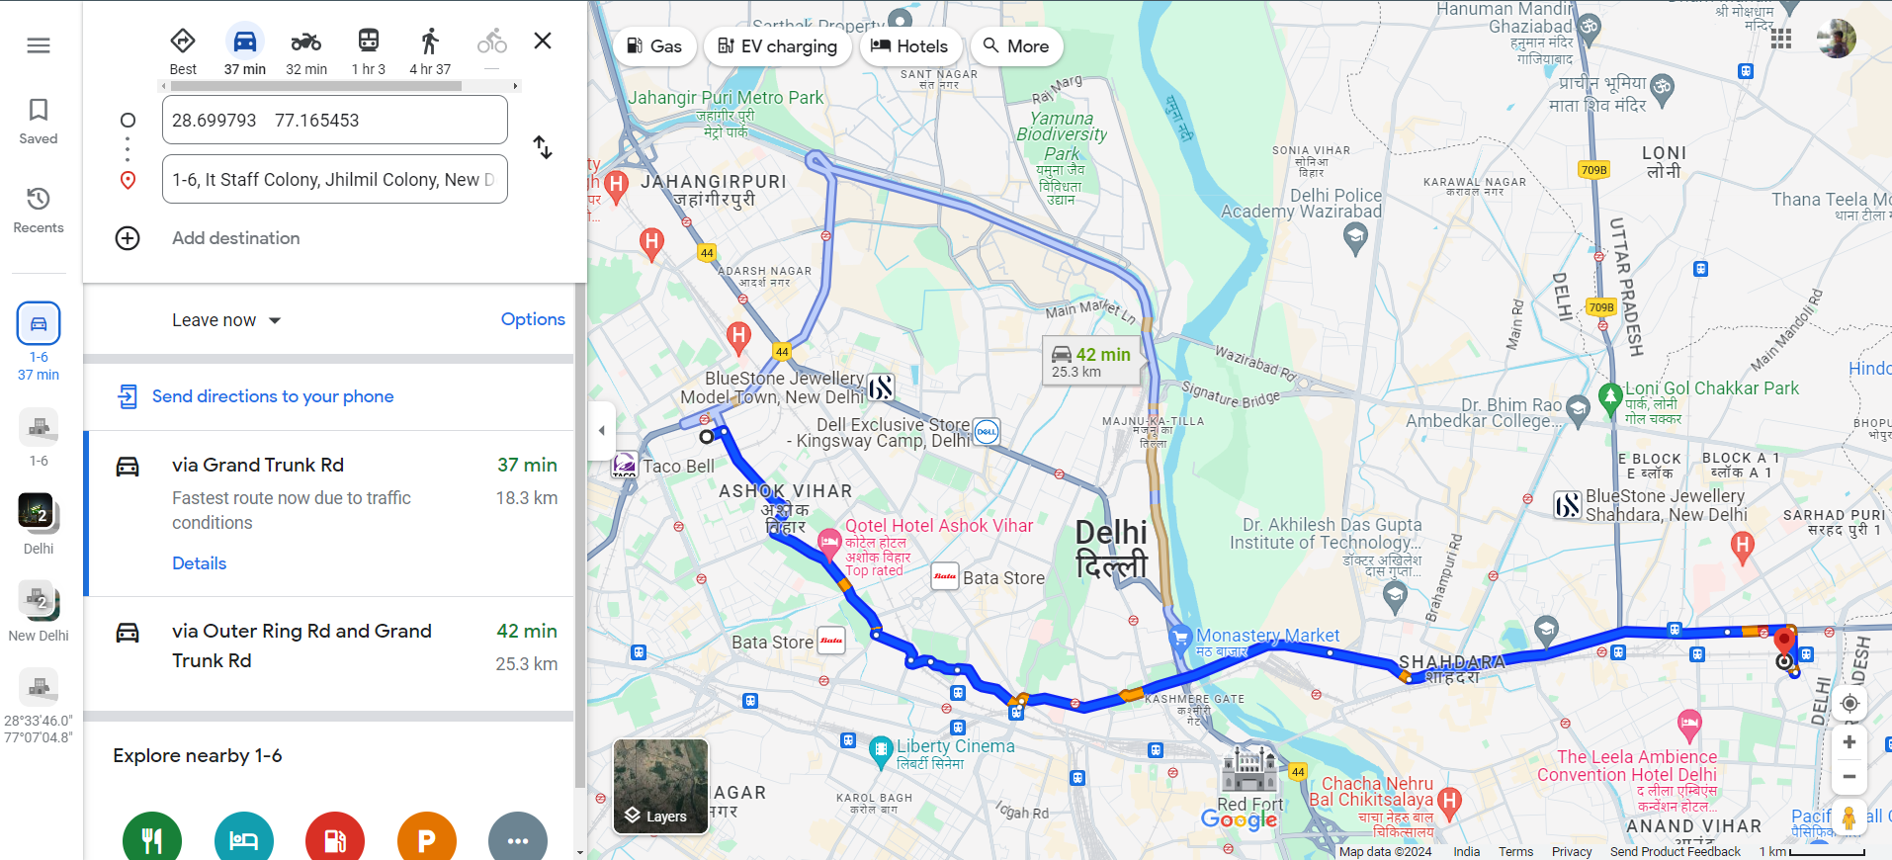
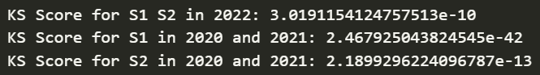
Nearby Stations

Slide 34
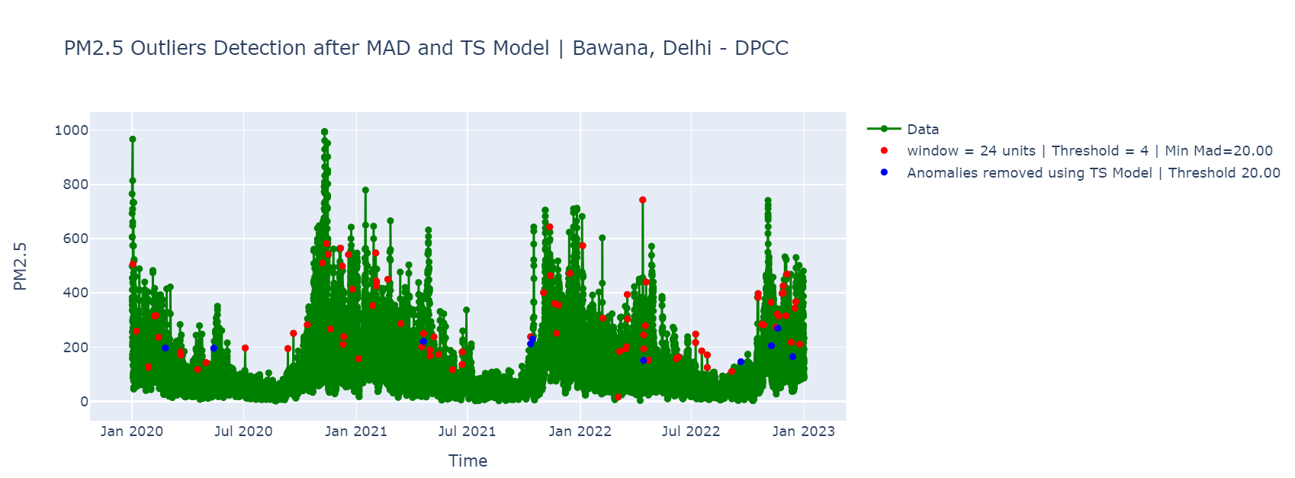

Slide 35
THANK YOU!

